Slide 1
Empowering Diabetes Managemen
Phase 3

Slide 2
Introduction
This presentation is on our Empowering Diabetes Management project. In this phase, we dealt with the class imbalance and attempted to develop a classification model.

Slide 3
Data Overview
We conducted Exploratory Data Analysis (EDA) on our diabetes_012_health_indicators_BRFSS2015 dataset to assess its quality. Notably, all values are numeric, and there are no missing values, eliminating the need for data preprocessing

Slide 4
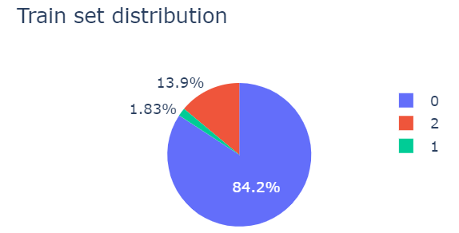
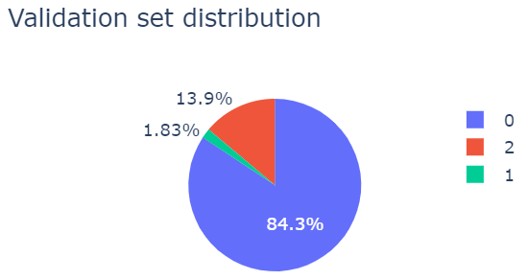
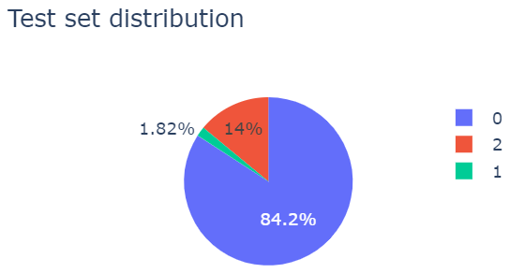
Data Points Distribution
The classification process involves Stratified data splitting into training, validation, and test sets. creating sets with an 80% train, 10% validation, and 10% test distribution.
Our dataset exhibits a significant class imbalance issue, which led us to explore various methods to address this challenge.

Slide 5
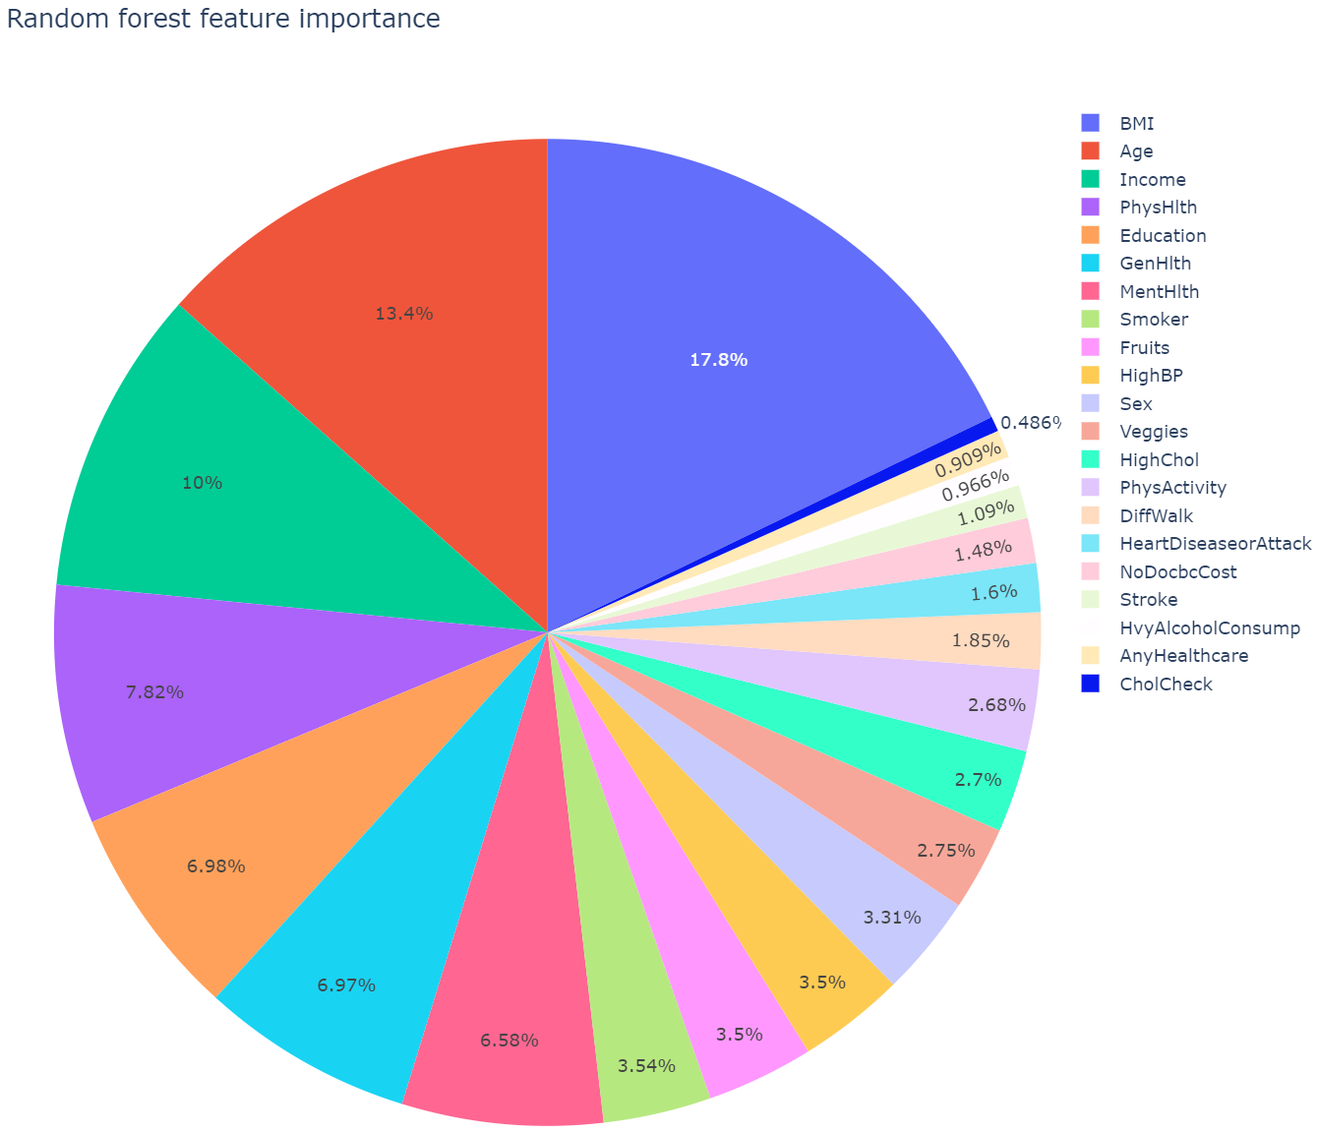
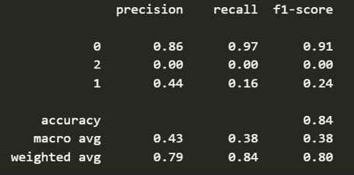
Classifier
We used a Random Forest classifier and performed grid search cross-validation to determine the best hyperparameters. The scoring parameter used was weighted ROC AUC score.

Slide 6
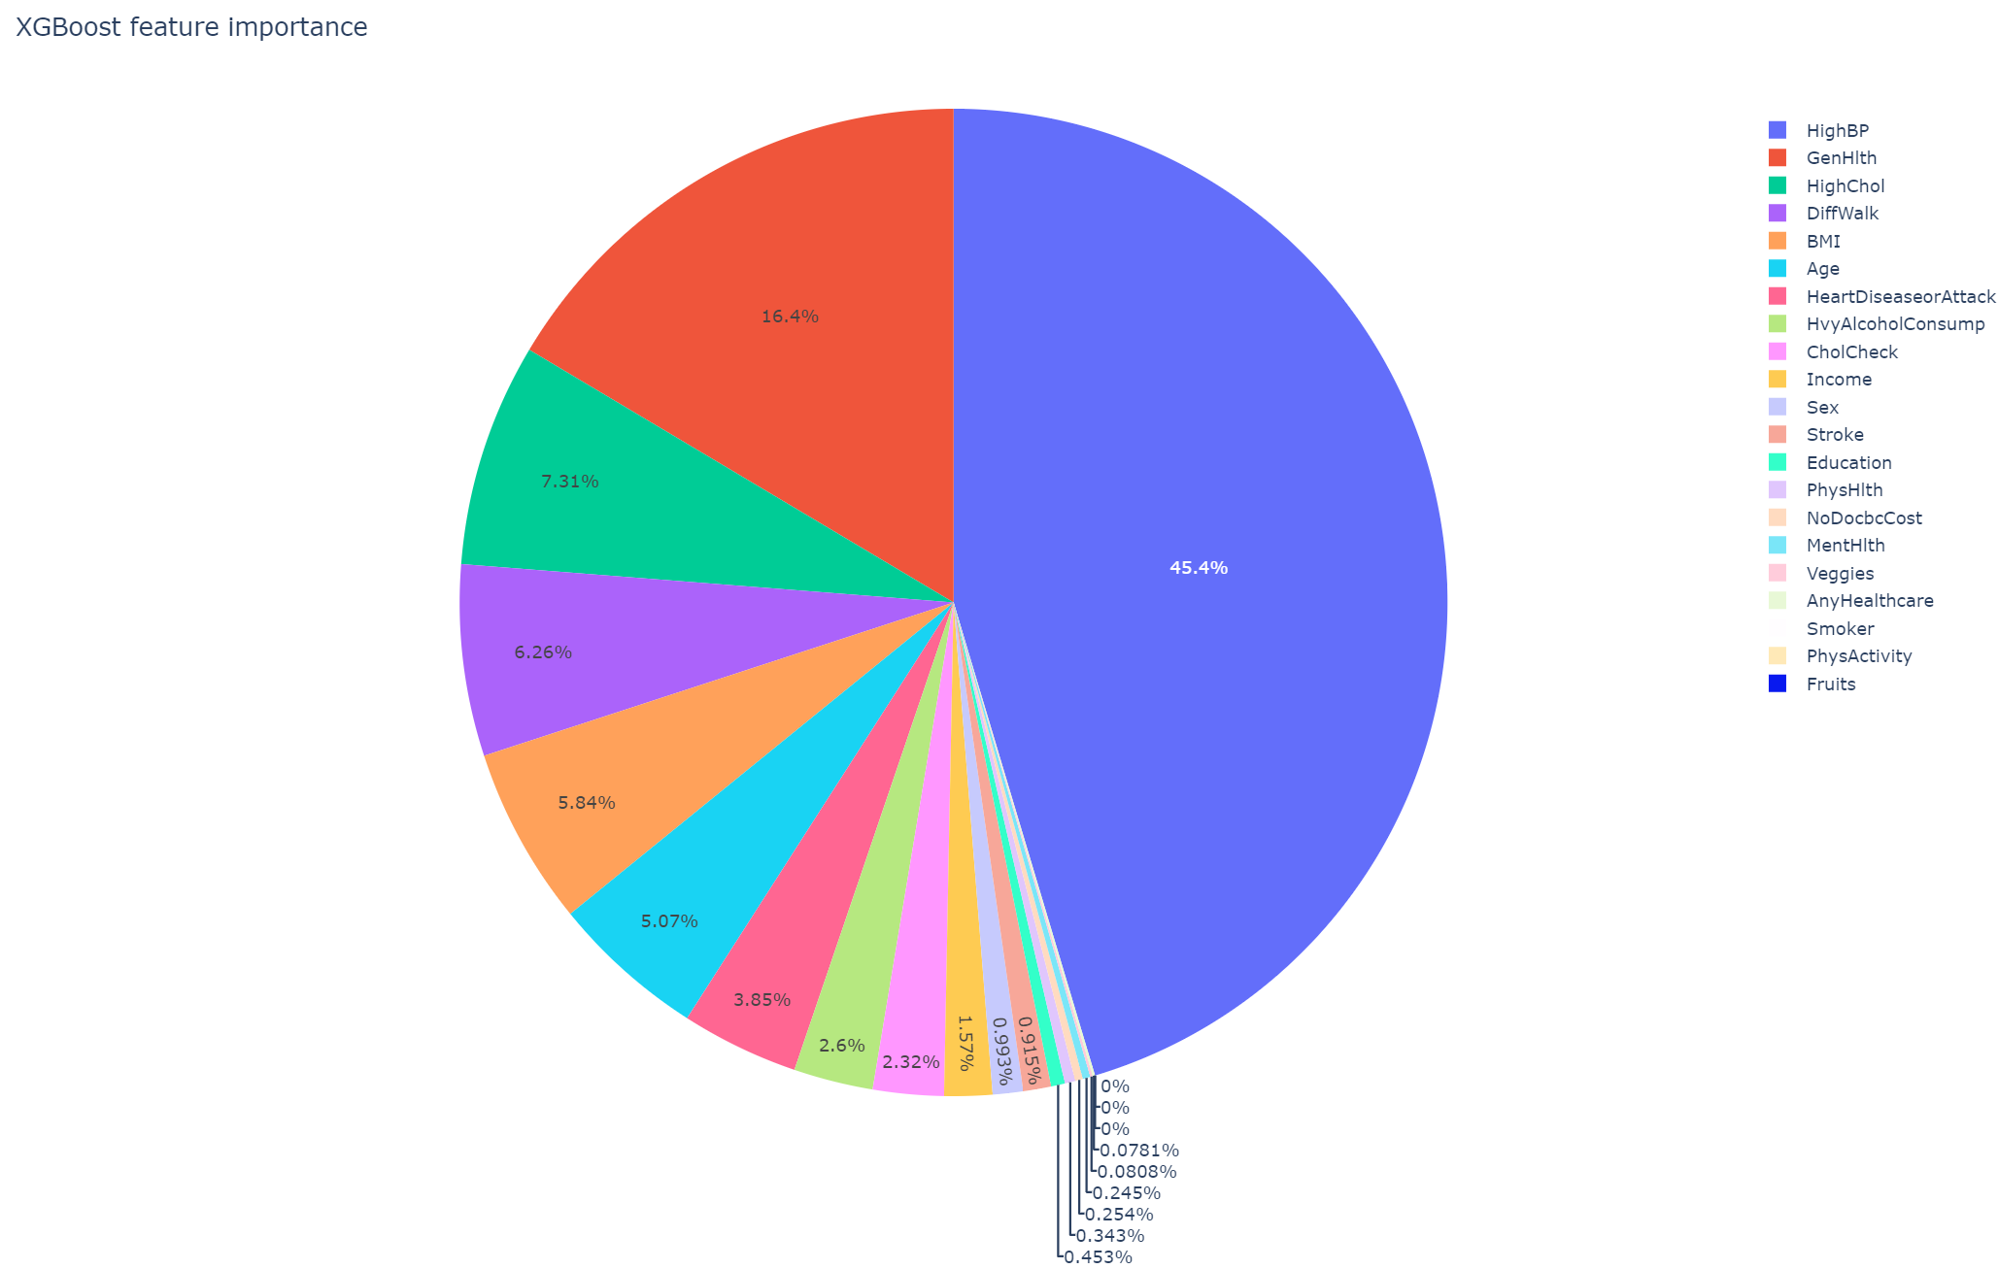
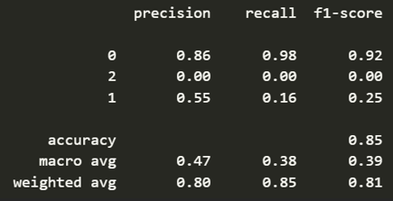
Classifier (cont.)
After Random Forest, we explored the XGBoost classifier, utilizing grid search to find the best parameters based on the weighted ROC AUC score.

Slide 7
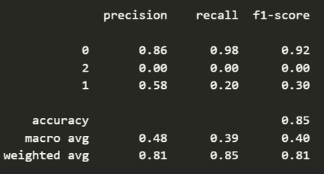
Classifier (cont.)
Since we are dealing with a significant class imbalance, we relied on the boosting method. As the XGB model failed, we tried another booster model, LightGBM. We get the best model based on grid search for the best-weighted ROC AUC score. We even tried adding custom weights to this model to see if it helps with class imbalance issue.
This model does not have a feature importance parameter, so we directly move on to performance analysis.
The above figure shows that LightGBM is also not very effective in dealing with class imbalance.

Slide 8
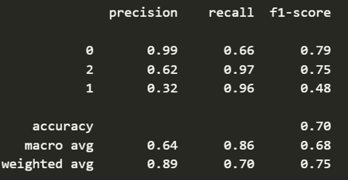
Random Forest with Resampled Data
Looking at all the results we decided to try out the same methods again using resampling techniques. For this, the imbalanced_learn module is used. We tried under sampling class 0 and over sampling class 1, and then checked performance of the best random forest model with best parameters that is now trained on resampled training dataset.

Slide 9
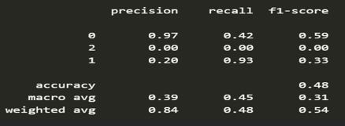
Resampling and XGBoost
We also checked how the resampled training set changes the performance of the XGBoost model.
We observed that random forest performed much better.

Slide 10
FitBit
The Fitbit API allows developers to access health and fitness data such as movement, sleep, and heart rate from Fitbit devices. Access to this data is granted by creating a registered application through a Fitbit developer account, following OAuth 2.0 authorization. The API provides specific endpoints for different types of data, and the responses are in JSON format.

Slide 11
Next Phase Work
To achieve better classifier performance, we plan to explore hyperparameter tuning and other methods like support vector machines or neural networks in future work.
we plan to implement SMOTE to address data imbalance and will compare its performance with previous resampling methods. This comparative analysis aims to assess the effectiveness of SMOTE in improving classifier performance

Slide 12
Thank you

